Slide 1
Back-End (.Net Core)
Members
Balaji Ramamurthy
Niraj Kumar
Manraj Singh Hanjra
Vasu Nagori
Yanish Bansal
Rishu Rana

Slide 2
Use Of ChatGpt application
We have used ChatGPT application to implement Micro Service, Controller and Dependency Injection. We asked ChatGPT to write sample programs. Please view the attached word document to glance through our journeys.

Slide 3
Use of ChatGPT to document test
We had used Genie to generate test documents. PFA the word document.

Slide 4
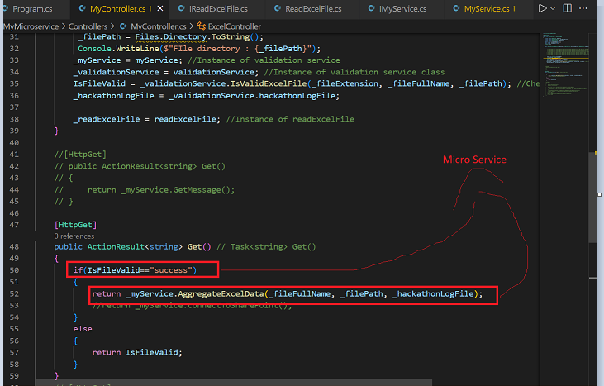
Implementation of Micro Service
We have implemented 2 Micro Service – one to validate the file and its data (ValidationService.cs) and the other to generate output if validation is a success (MyService.cs)
Please see the screen snapshot –

Slide 5
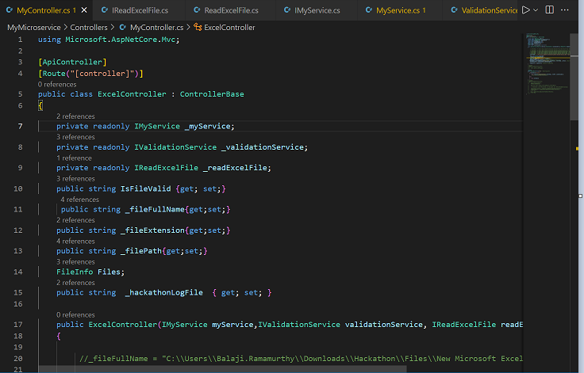
Implementation Of Controller Class
We have implemented a Controller class “ExcelController” which controls the execution of the Micro Services

Slide 6
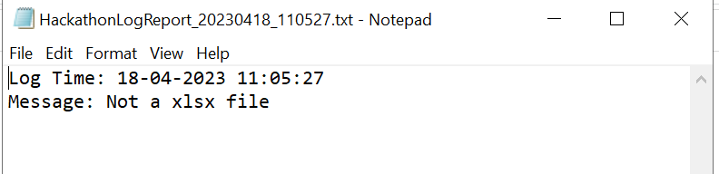
Implementation of Validations – Wrong Type Of File
We are generating a Hackathon Log file to validate ‘Wrong Type of File’. Please take a note processing is stopped when this validation fails.

Slide 7
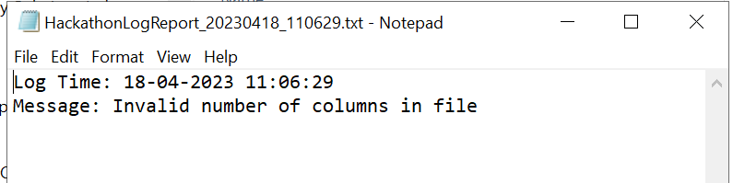
Implementation of Validations – Wrong number of Columns
We are generating a Hackathon Log file to validate ‘Wrong number of Columns’. Please take a note processing is stopped when this validation fails.

Slide 8
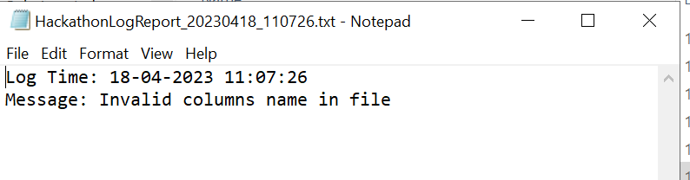
Implementation of Validations – Wrong Column Names
We are generating a Hackathon Log file to validate ‘Wrong Column Names’. Please take a note processing is stopped when this validation fails.

Slide 9
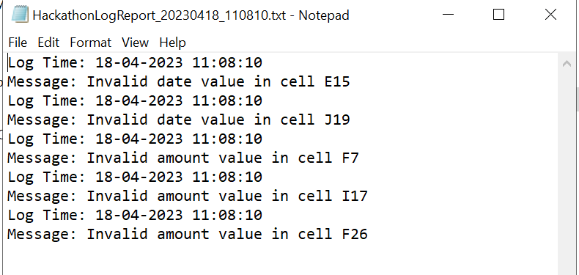
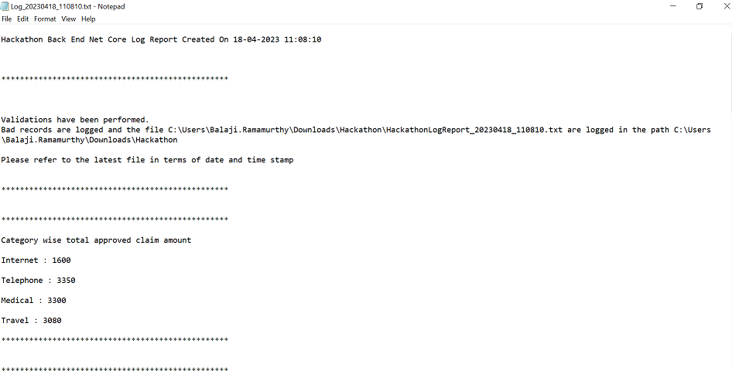
Implementation of Validations – Invalid Date Type and Amount Value
We are generating a Hackathon Log file to validate ‘Invalid Date Type and Amount Value’. Please take a note processing is NOT stopped in case this validation fails. Along with Hackathon Log file, another Output Log file is also generated.

Slide 10
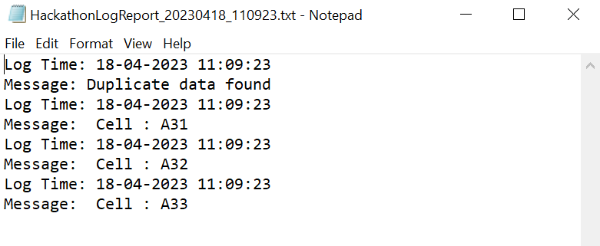
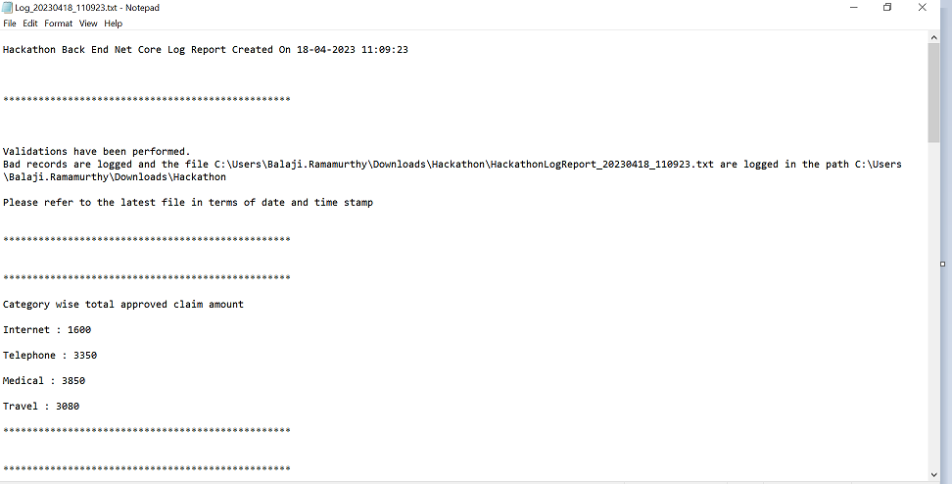
Implementation of Validations – Duplicate data
We are generating a Hackathon Log file to validate ‘Duplicate Data’. Please take a note processing is NOT stopped in case this validation fails. Along with Hackathon Log file, another Output Log file is also generated.

Slide 11
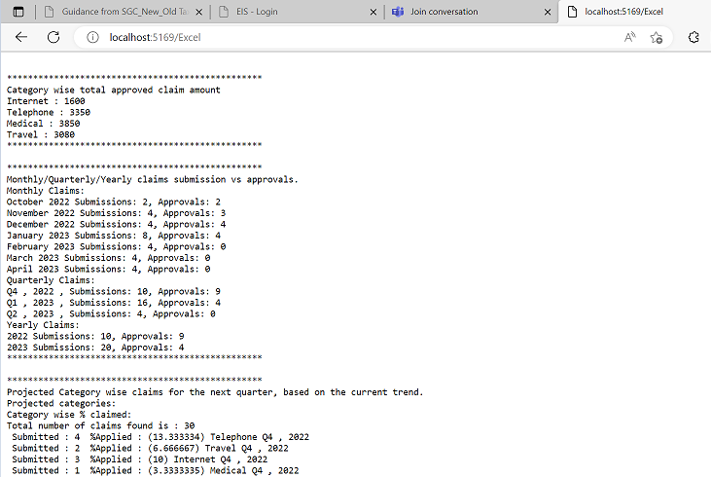
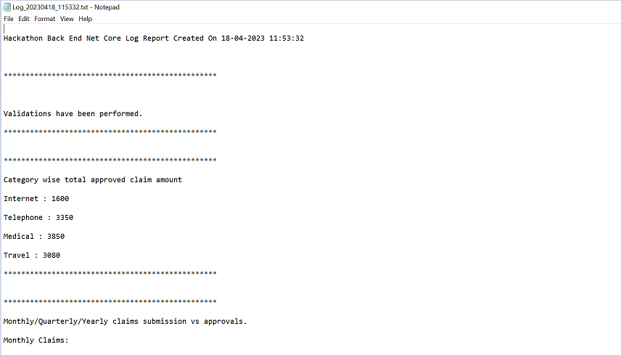
Logging of Output File when Validation is Success
When Validations are complete, only the Output Log file is generated.

